Slide 1


A Review of Negative Transfer in Aviation Safety
Kristen Cook

Slide 2
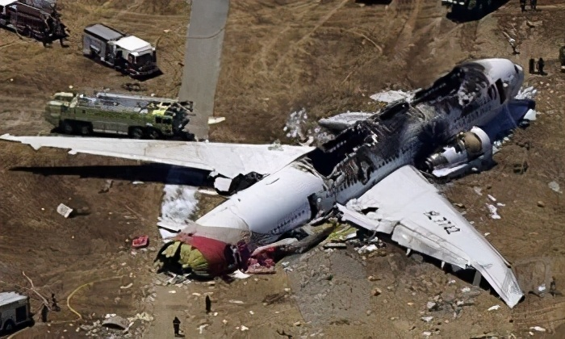
Overview
Transfer of Learning
Types
Theories
Negative Transfer in Aviation
Primary Causes
Examples
Reason's Model of Error
Prevention & Mitigation
China Airlines Flight 140 (1994)
Notes:
- China Airlines Flight 140 (1994)
stalled during an instrument approach and crashed into the runway at Nagoya Airport. Aircraft had been leased temporarily to fill plane shortage. Leased aircraft had “subtle differences” in cockpit layout/systems, especially in regards to ILS switching and had the Mode 5 warning system inhibited (the system that alerts the crew to excessive glideslope deviations and GPWS alerts) , due to different airworthiness requirements in the owners/operator’s country. This Mode 5 inhibition was not on the aircraft forms (that would have notified the pilots of the difference) nor covered in the crews brief “differences” training.
(264 of the 271 occupants were killed).

Slide 3
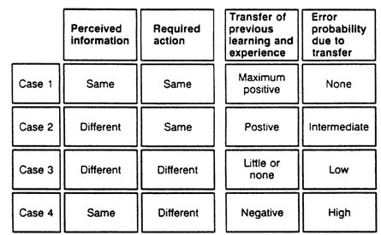
Transfer of the Learning (training transfer)
“Applying previously learning information, skills, and/or strategies to a different context or situation that it was initially learned in”
Transfer of Learning vs. Ordinary Learning
Positive vs. Negative Transfer
Near vs. Far Transfer
+
-
Braune, 1989

Slide 4
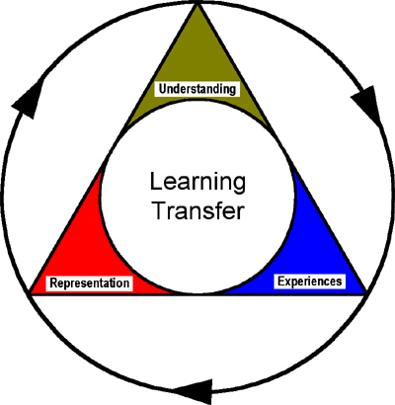
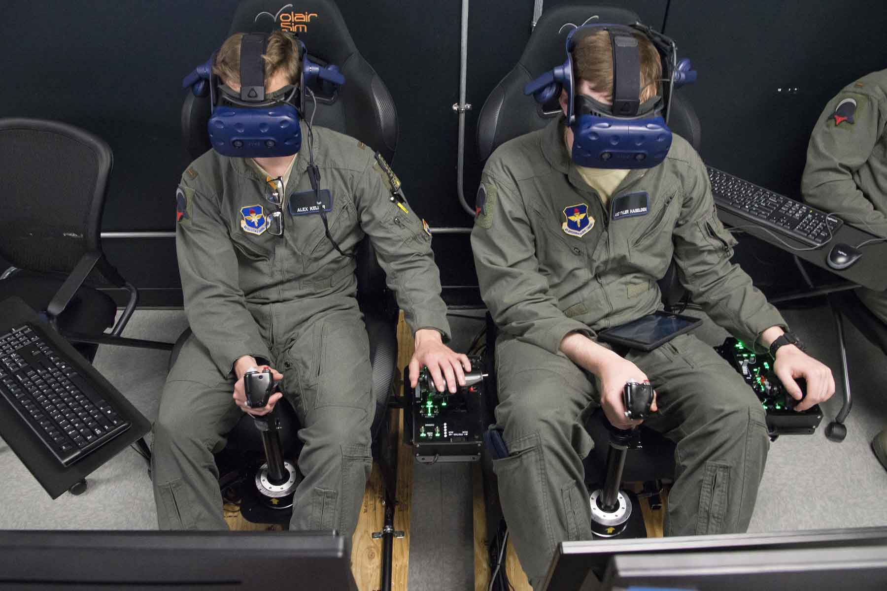
Theories of Transfer of Learning
Theory of Identical Elements (Thorndike & Woodworth, 1901)
Level of transfer dependent on level of “similar elements”
Theory of Generalization of Experience (Judd, 1908)
Degree of transfer depends on level of general understanding of info/skills
Constructivism Learning (Bednar, 1995; Kolmos, 2018)
Degree of transfer related to degree that training environment mirrors real-world situations
“learning by doing” approach
Best for experienced students vs. novices
Key for learning in aviation

Slide 5
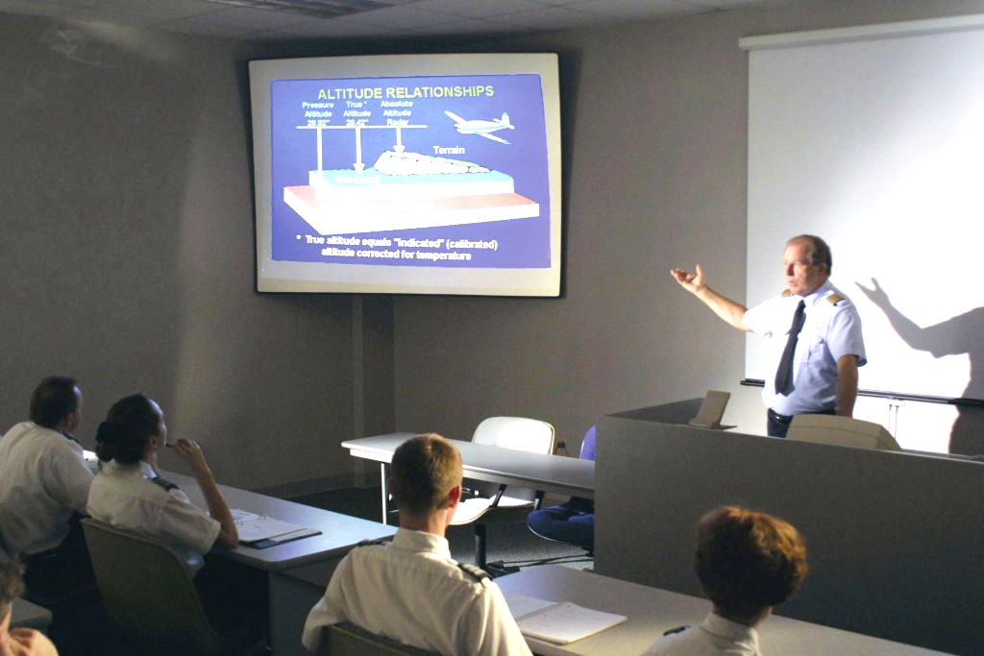
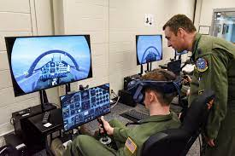
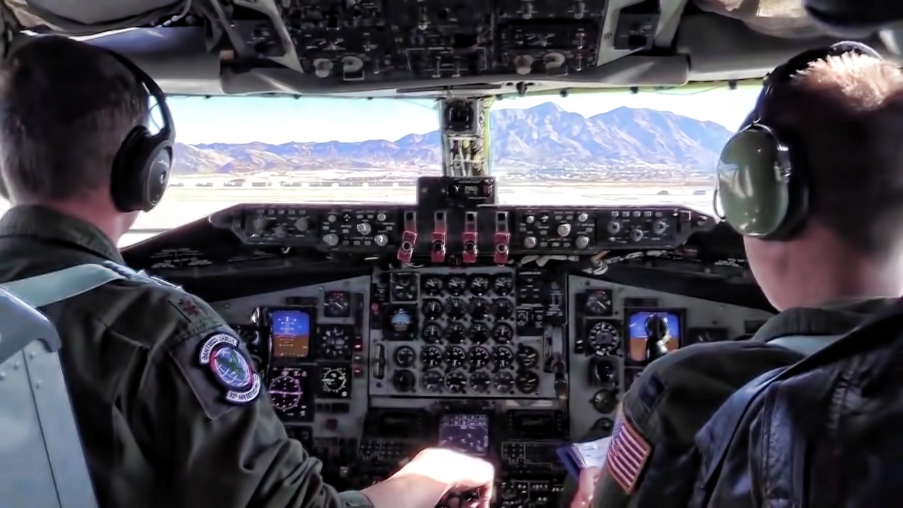

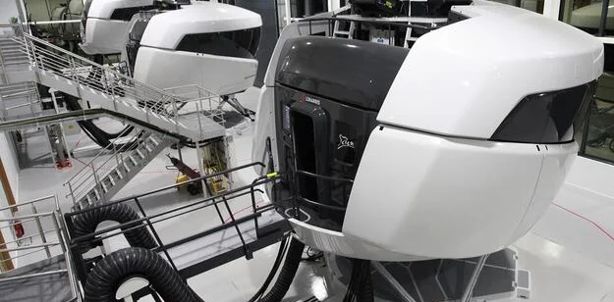
Transfer of Learning in Aviation
Positive Transfer
Classroom → Simulator → Aircraft
System 1 vs System 2 Thinking (Kahneman’s Cognitive Model)
Risk of negative transfer with System 1 (fast thinking)

Slide 6
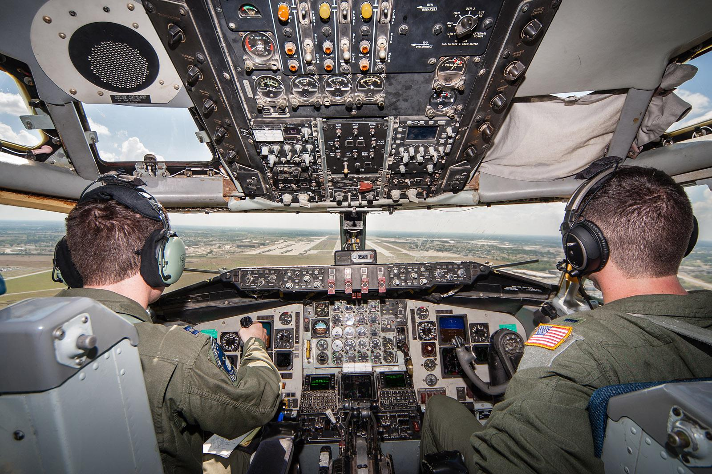
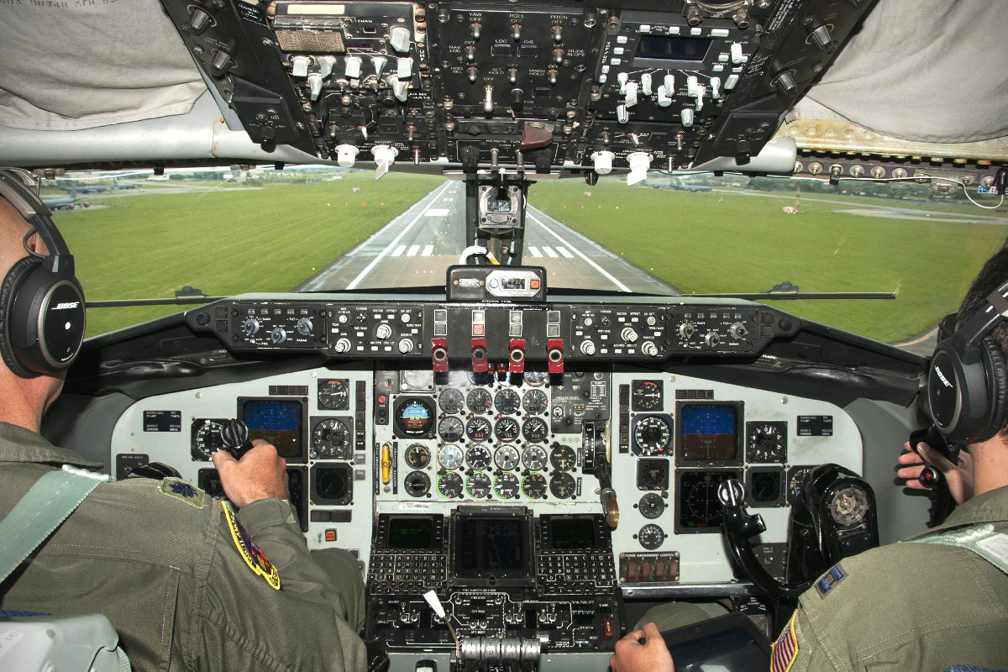
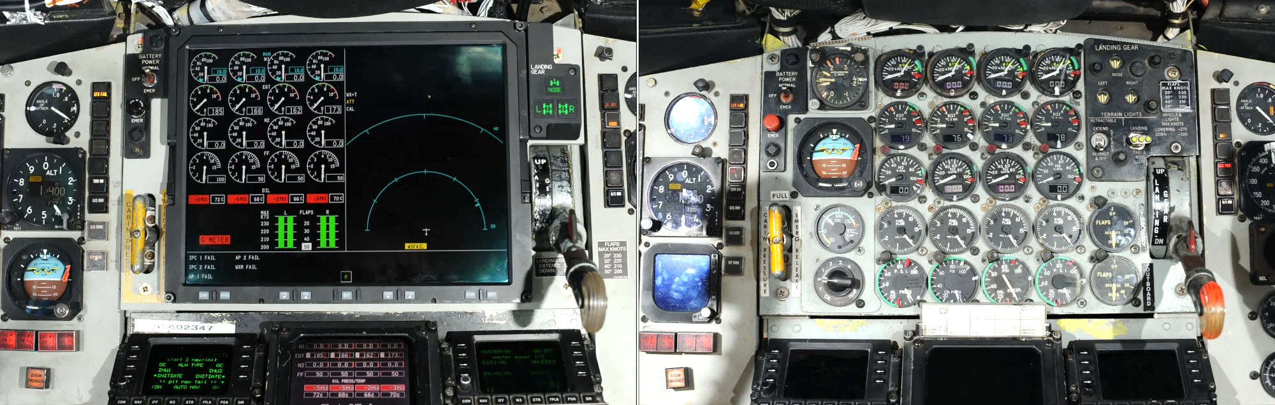
Negative Transfer in Aviation
Primary Causes:
Flight Simulator Training Fidelity
Transference from Piloting Other Types of Aircraft
Flight Deck Updates – Advancing Technology
Which one is the simulator?
vs.

Slide 7

Flight Simulators
Uses:
Initial pilot training
Aircraft type-specific familiarization
Emergency/high-risk maneuver training
Upset prevention/recovery training (UPRT)
Sim Training Effect on Transfer Studies:
“Simulator fidelity: The effect of platform motion” (Burki-Cohen, 2001)
“The effect of simulator platform motion on pilot training transfer: A meta-analysis” (Vaden & Hall, 2005)
“Transfer of training on the vertical motion simulator” (Zall & Schroeder, 2015)
“Transfer of training and the measurement of training effectiveness “ (Blaiwes, 2001)

Slide 8
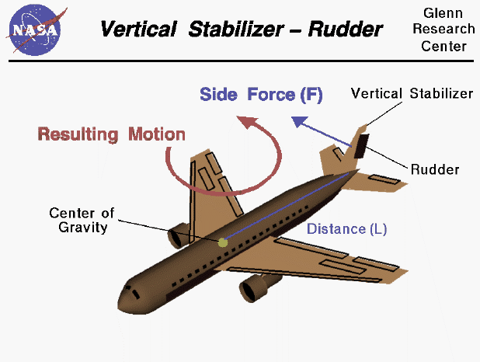
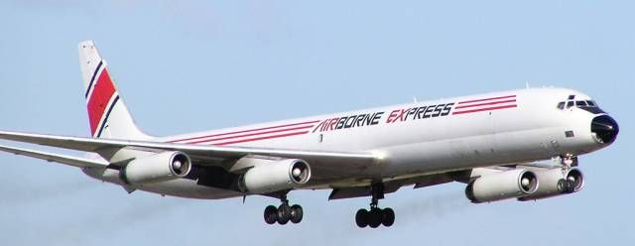
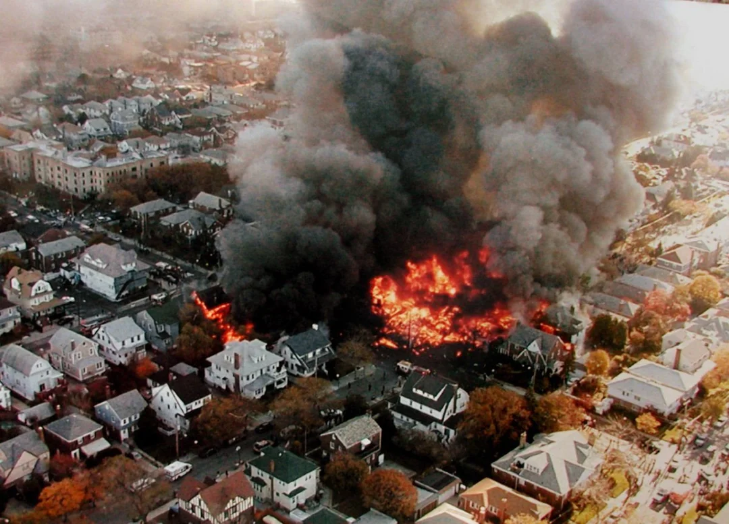
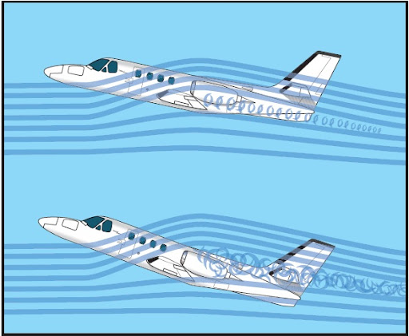
Mishap Examples
Poor simulator fidelity → negative transfer → contributing factor in mishap
AA Flight 587 (2001)
Airborne Express Flight 827 (1996)

Slide 9
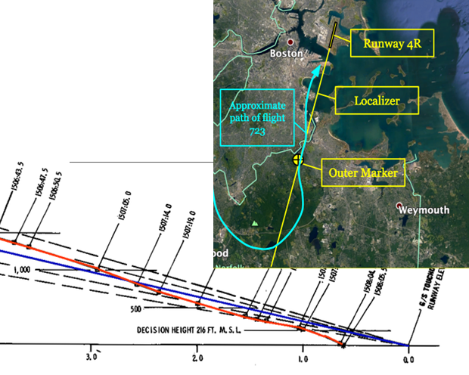
Cockpit Updates Advanced Technology & New Flight Systems/Instruments
Negative transfer due to subtle system changes more likely when something unexpected/out of the norm occurs (e.g. IFE)
More experienced pilots struggle the most when transitioning to TAA (Technically Advanced Aircraft) vs. novices (Hamblin, Gilmore & Chaparro, 2006)
‘unlearning’ old technique to learn new one increases likelihood of error (Bell &Williams, 2017)
Mishap Example:
Delta Flight 723 (1973)

Slide 10
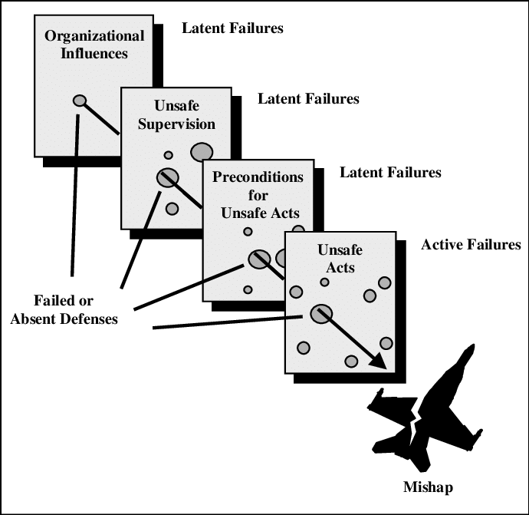
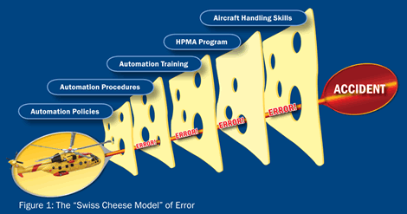
Reason’s Model of Error “Swiss Cheese Model” (SCM)
Error Path – when weaknesses (holes) in the indiv. safety barriers align, leading to an unsafe outcome/major accident
Negative Transfer = “preconditions for/unsafe acts” layer
Notes:
severity within the aviation community.

Slide 11
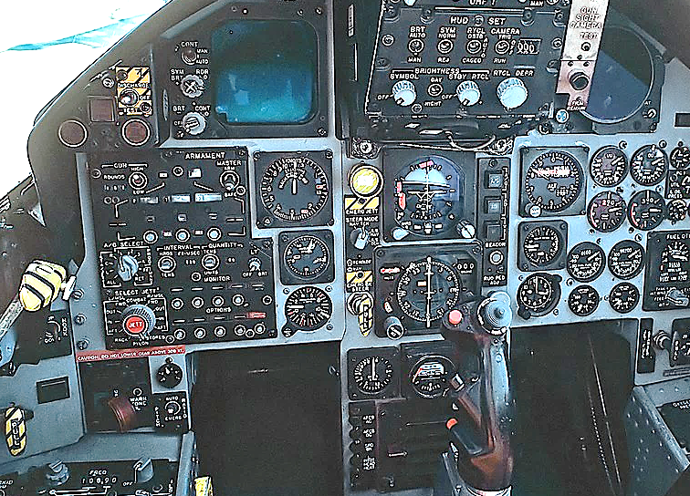
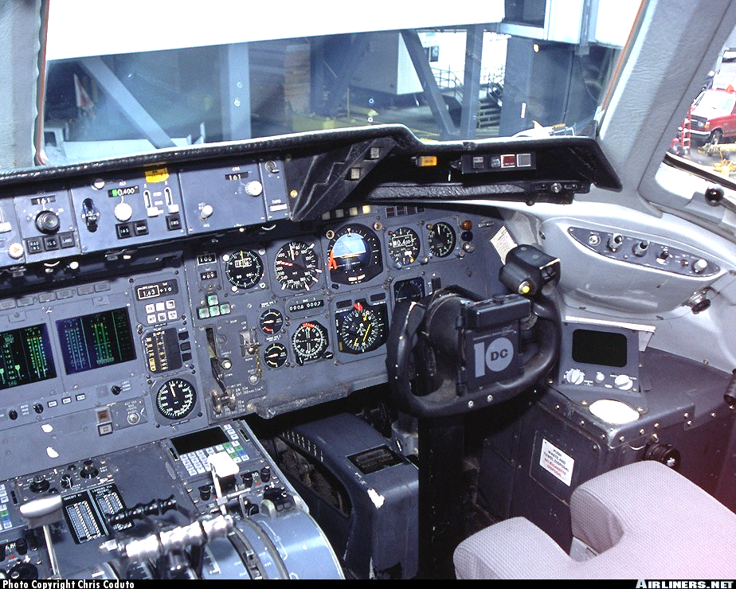
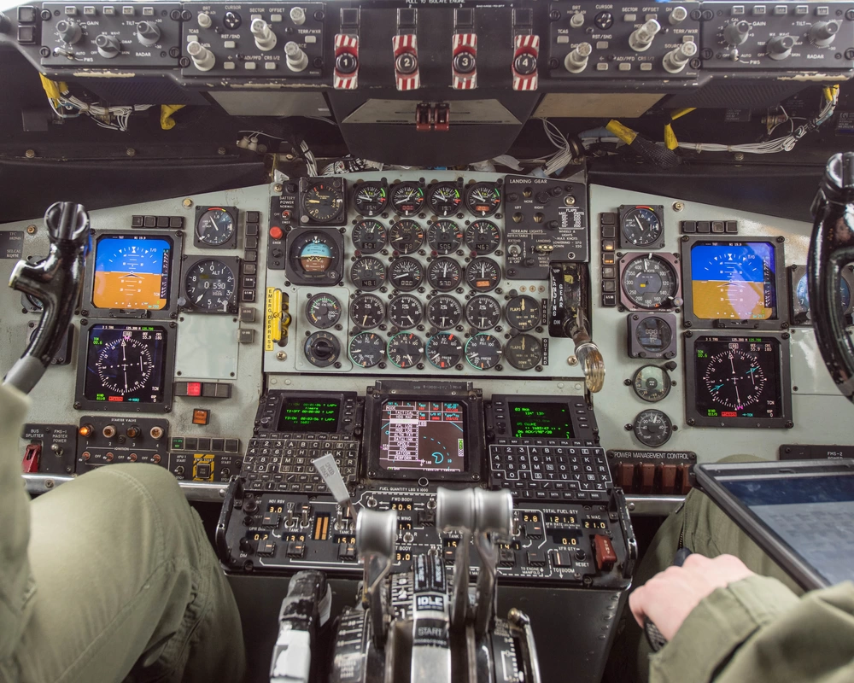
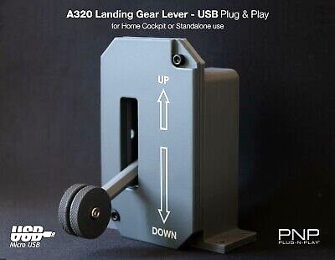
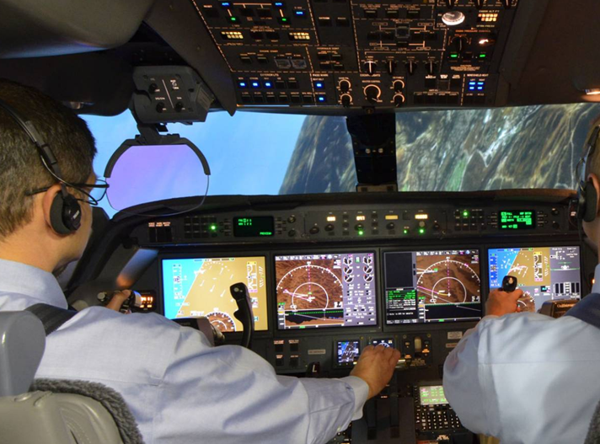
Prevention & Mitigation
Aircraft & Instrument Design Considerations
Flight Simulator Training
Simulator fidelity (Roscoe & Williges, 1980)
Flight instructors (Valverde, 1973)
Reteaching experts – retraining techniques
Novice vs experienced pilots (Summers et al, 2007)
Landing gear & flap lever standardization
Control guards & switch placement
Alert/warning systems
KC-135
DC-10
F-15

Slide 12
Questions

Slide 13
References
Bednar, A. K., Cunningham, D., Duffy T. M. & Perry J. D. (1995). Theory into Practice: How do we Link? Instructional Technology: Past, present and future. Englewood, CO: Libraries Unlimited, pp 100-112.
Bell, J.L and Williams, J.C. (2017). Evaluation and Consolidation of the HEART Human Reliability Assessment Principles. Pp. 3 – 12. Advances in Human Error, Reliability, Resilience, and Performance. Proceedings of the AHFE 2017 International Conference on Human Error, Reliability, Resilience, and Performance, July 17 – 21, 2017, LA, California, USA. R.L. Boring (Ed.). Published by Springer.
Braune, R. (1989). The Common/Same Type Rating: Human Factors and Other Issues. SAE Technical Paper 892229, 1989, https://doi.org/10.4271/892229
Perkins, D.N., & Salomon, G. (1992). Transfer of learning. International Encyclopedia of Education, Second Edition. Oxford, England: Pergamon Press. http://learnweb.harvard.edu/alps/thinking/docs/traencyn.htm
Roscoe, S. N., & Williges, B. H. (1980). Measurement of transfer of training. In S. N. Roscoe (Ed.), Aviation psychology (pp. 182-193). Ames: Iowa State University Press.
Summers, M., Ayers, F., Connolly, T., & Robertson, C. (2007). Managing risk through scenario-based training, single pilot resource management, and learner centered grading. http://www.faa.gov/training_testing/training/fits/guidance/media/RM_thor ugh_SBT.pdf
Valverde, H. H. (1973). A review of flight simulator transfer of training studies. Human Factors: The Journal of the Human Factors and Ergonomics Society, 15(6), 510-522. doi:10.1177/001872087301500603

